Slide 1
SALARY PREDICTION SYSTEM
Internship Project Presentation for Spinnaker analytics
Developed by Farhan

Slide 2
Title & Overview
Salary Prediction System
Machine learning–based system to predict expected salaries
Focused on NYC government job postings
Uses both structured job attributes and unstructured text data
Covers complete ML lifecycle: data → model → deployment
Tools Used
Python, Pandas, NumPy
Scikit-learn
Streamlit

Slide 3
Problem Statement & Motivation
Problem Statement
Salary determination varies widely across job roles and levels
Manual analysis is time-consuming and often inconsistent
Lack of transparency makes salary estimation difficult
Motivation
Automate salary prediction using historical job data
Identify salary patterns based on job characteristics
Apply machine learning to a real-world compensation problem

Slide 4
Dataset Description & Target Variable
Dataset Overview
Source: NYC Government Job Postings
Real-world dataset with structured and unstructured fields
Key Features
Job Category
Career Level
Agency
Employment Type
Job Description & Skills
Target Variable
Salary midpoint calculated as:
(Salary Range From + Salary Range To) / 2

Slide 5
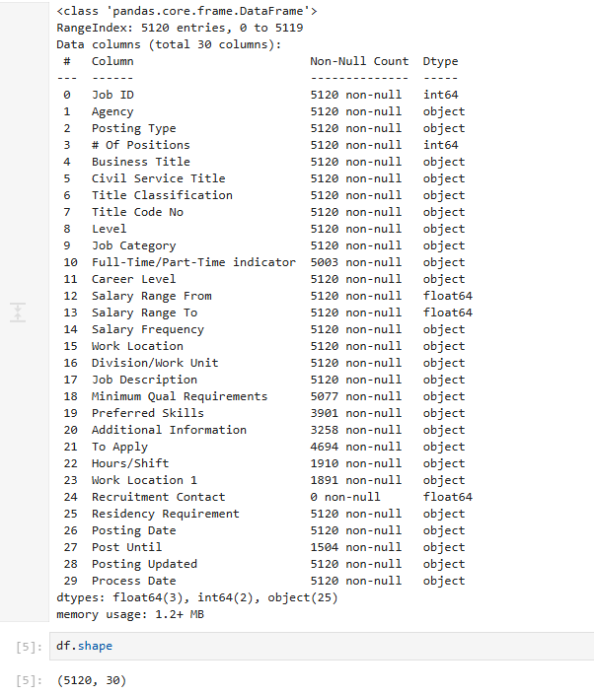
DATA INFO

Slide 6
Data Cleaning Process
Cleaning Steps Performed
Removed records with missing salary values
Handled missing numerical values using imputation
Filled missing categorical values with default categories
Cleaned and combined textual fields
Removed duplicate job postings
Outcome
Clean, consistent, model-ready dataset

Slide 7
Exploratory Data Analysis (EDA)
Key Observations
Salary distribution is right-skewed
Senior and executive roles earn significantly higher salaries
Full-time roles generally pay more than part-time roles
Certain job categories and agencies consistently offer higher pay
Visualizations Used
Salary distribution plots
Box plots by career level and job category

Slide 8
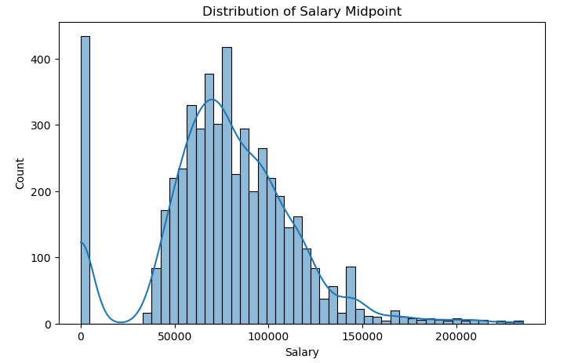
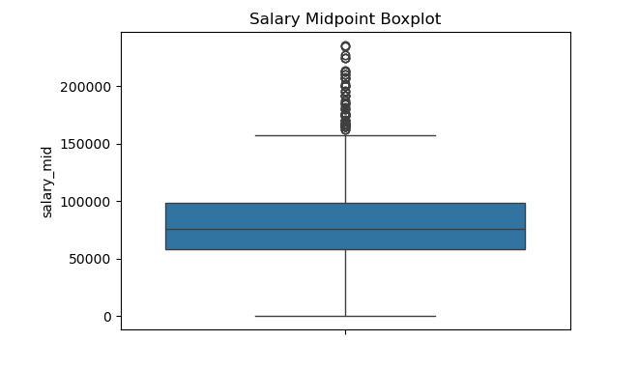
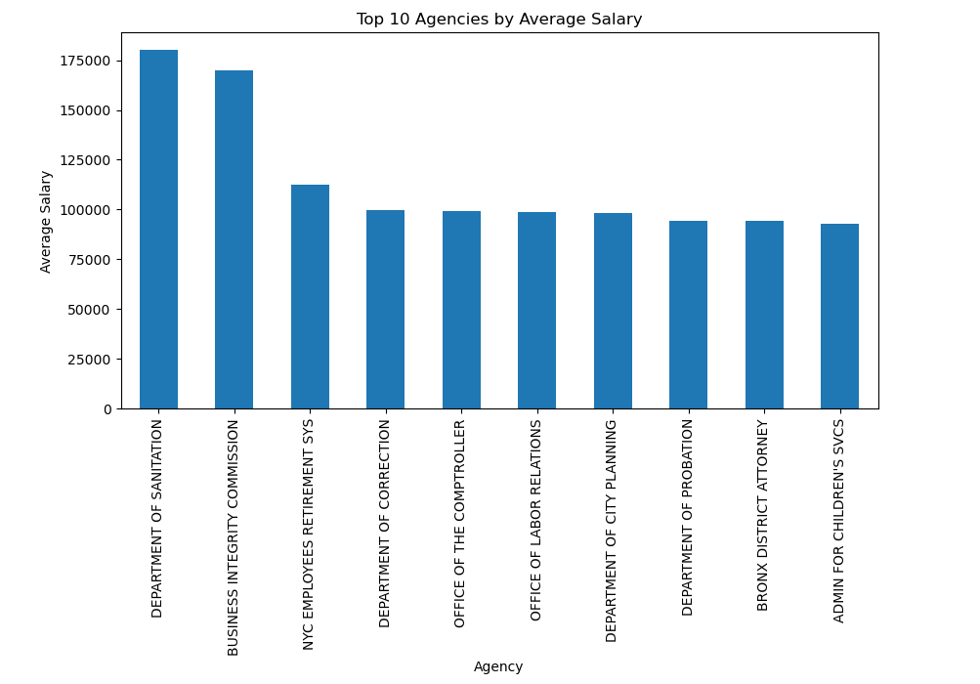
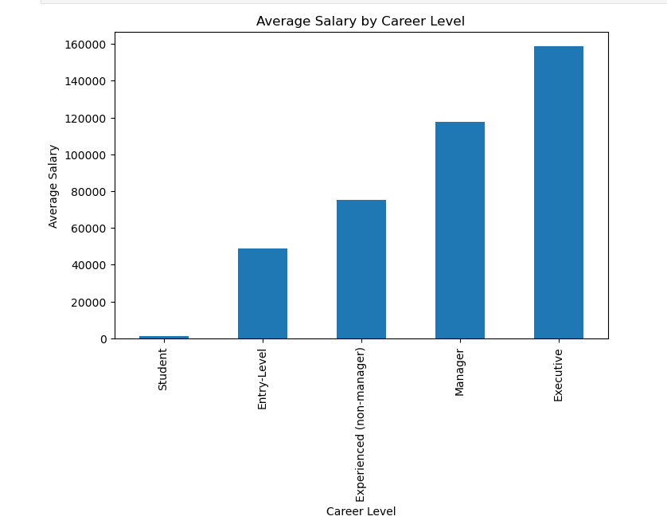
EDA GRAPHS

Slide 9
Feature Engineering
Structured Feature Engineering
Binary feature for employment type (full-time / part-time)
Reduced high-cardinality agency names
One-hot encoding for categorical variables
Unstructured Feature Engineering
Combined job description, skills, and qualifications
Applied TF-IDF vectorization
Extracted important keywords and patterns
Result
Unified feature matrix with structured + text data

Slide 10
Models Used & Evaluation Strategy
Models Implemented
Linear Regression (baseline)
Random Forest Regressor
Gradient Boosting Regressor
Evaluation Metrics
RMSE – measures prediction error
R² Score – explains variance in salary
Accuracy (±10%) – business-friendly metric
Accuracy Definition
Prediction is correct if within ±10% of actual salary

Slide 11
Model Performance & Selection
Model Comparison Summary
Linear Regression: simple baseline, limited performance
Gradient Boosting: moderate error, unstable with text features
Random Forest: best balance of accuracy and stability
Best Model
Random Forest Regressor
  Lowest RMSE
  Highest R² score
  Best tolerance-based accuracy

Slide 12
Hyperparameter Tuning & Deployment
Hyperparameter Tuning
Tuned number of trees
Controlled tree depth
Adjusted minimum samples per split
Improved overall model stability
Deployment
Final model saved using Pickle
Deployed using Streamlit
Dropdown-based inputs
Real-time salary prediction with range

Slide 13
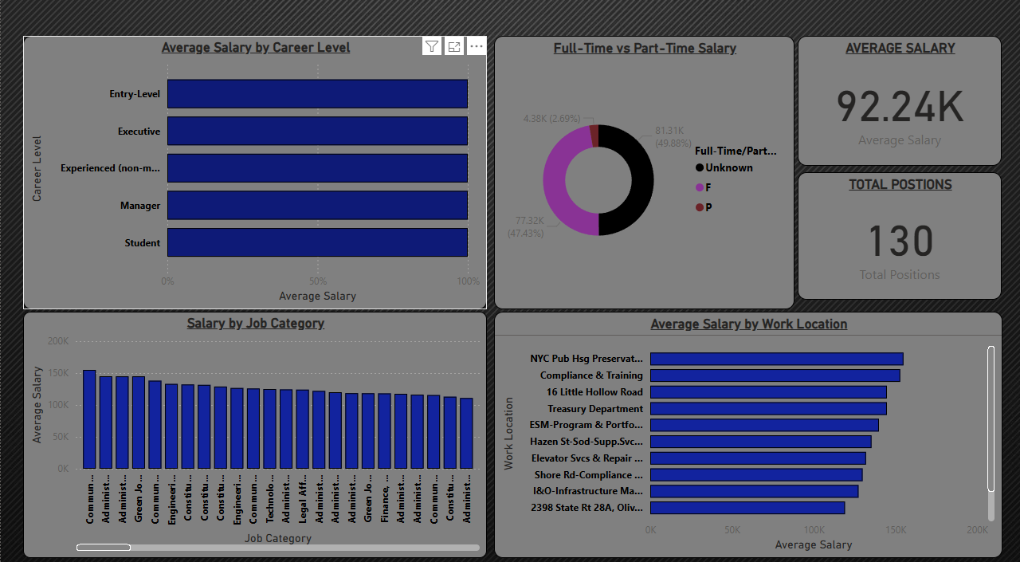
DASHBOARD POWER BI

Slide 14
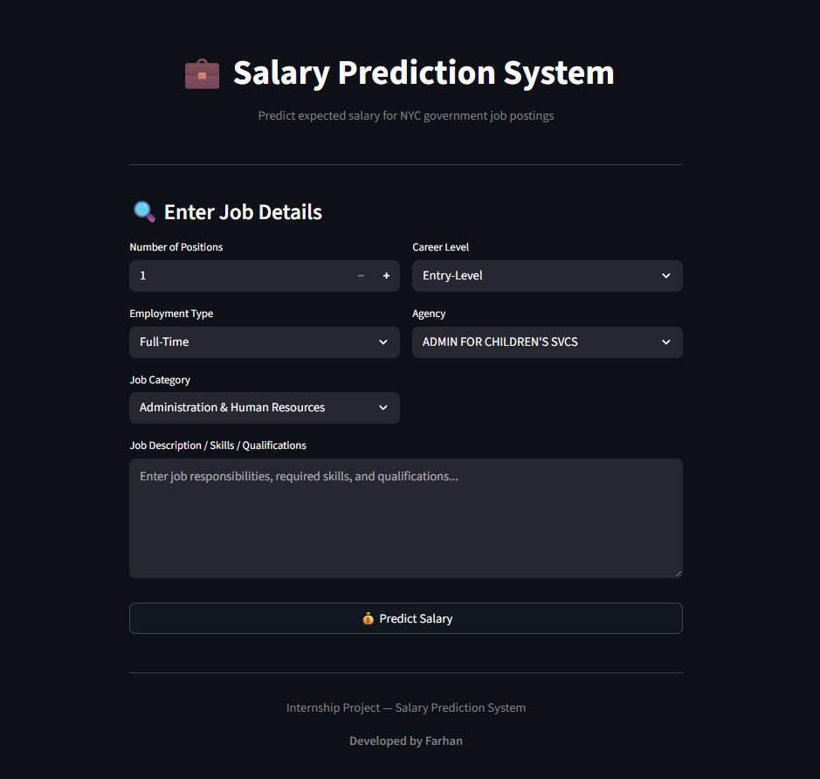
APP INTERFACE

Slide 15
Conclusion & Future Scope
Conclusion
Successfully built an end-to-end salary prediction system
Random Forest outperformed other models
Text + structured features significantly improved predictions
Project demonstrates real-world ML application
Future Scope
Use advanced NLP techniques
Automated hyperparameter tuning
Add explainability methods
Extend dataset to other regions

